Slide 1
Complex Task Series
Problem Number 1

Slide 2
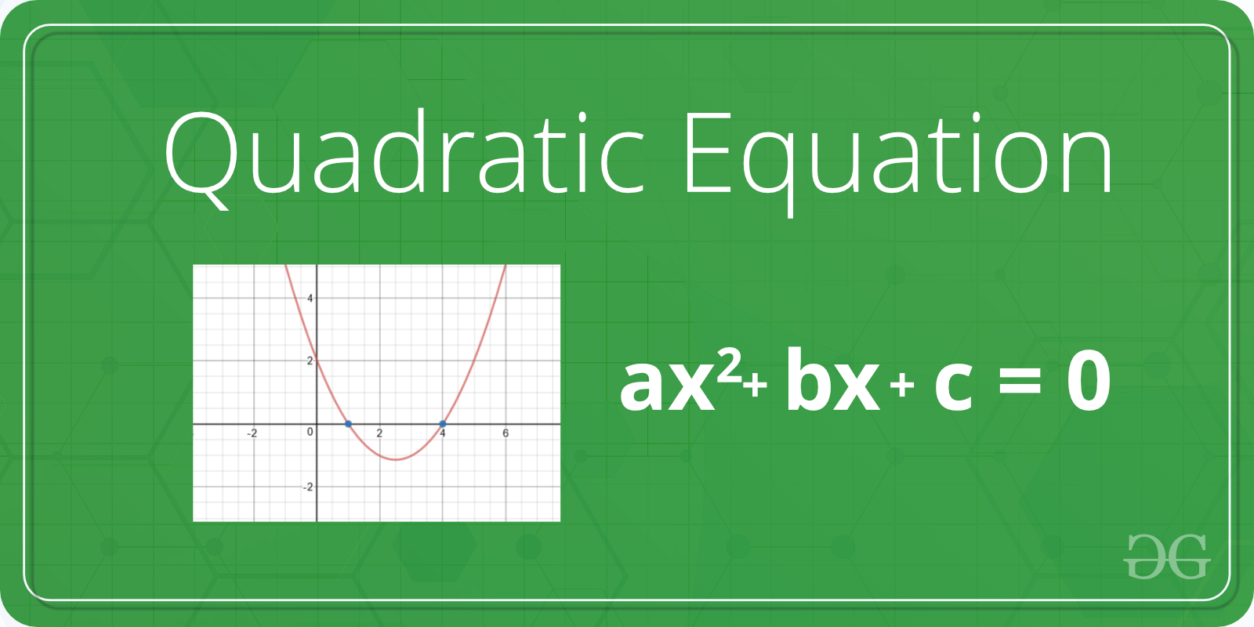
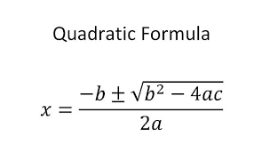
Problem Statement
Write a Python Program To Find Roots Of Quadratic Equation

Slide 3
Algorithm
Step1: Get 3 value of a, b and c
Step2: Find value of r (r = b**2 – 4 * a * c)
Step3: If r value greater than 0, display there are two roots
Step4: If r value equal to 0, display there is one roots
Step5: If r value less than 0, display no roots
END

Slide 4
Assignment
Write a Python Program To Find Roots Of Quadratic Equation: Make some modification

